Slide 1

First and Last Touch Attribution with CoolTShirts.com
Capstone
Ryan Brouk
7.18.18

Slide 2

Table of Contents
1. Get familiar with the company.
How many campaigns and sources does CoolTShirts use and how are they related? Be sure to explain the difference between utm_campaign and utm_source.
What pages are on their website?
2. What is the user journey?
How many first touches is each campaign responsible for?
How many last touches is each campaign responsible for?
How many visitors make a purchase?
How many last touches on the purchase page is each campaign responsible for
What is the typical user journey?
3. Optimize the campaign budget
CoolTShirts can re-invest in 5 campaigns. Which should they pick and why?

Slide 3
1. Get Familiar with the Company

Slide 4
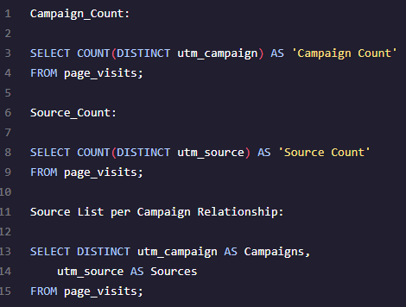
1. Get Familiar with CoolTShirts
How many Campaigns and Sources does CoolTShirts use? Which source is used for each campaign? What is the difference between utm_source and utm_source?
UTM_Source: Identifies which touchpoint sent the traffic (i.e. google, email, facebook, etc.)
UTM_Campaign: Identifies the specific ad or email blast (i.e. re-targeting, weekly-newsletter, etc.)
Campaign Count | Source Count
8 | 6
Campaigns | Source
getting-to-know-cool-tshirts | nytimes
weekly-newsletter | email
ten-crazy-cool-tshirts-facts | buzzfeed
retargeting-campaign | email
retargeting-ad | facebook
interview-with-cool-tshirts-founder | medium
paid-search | google
Cool-tshirts-search | google

Slide 5
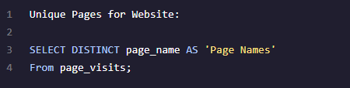
1. Get Familiar with CoolTShirts – Cont’d
What pages are on the CoolTShirts website?
Using a SELECT DISTINCT query provides the ability to get the answer needed
Campaigns
1 – landing_page
2 – shopping_cart
3 - checkout
4 - purchase

Slide 6
2. What is the User Journey?

Slide 7
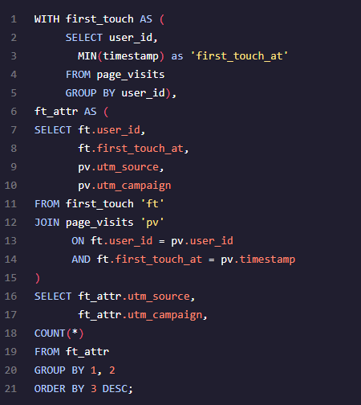
2. What is the User Journey?
How many first touches is each campaign responsible for?
Use the MIN statement to help determine which source and campaign first grabbed the users interest to bring them to the website
Total of 4 campaigns drove first touch
Source | Campaign | Count
medium | interview-with-cool-tshirts-founder | 622
nytimes | getting-to-know-cool-tshirts | 612
buzzfeed | ten-crazy-cool-tshirts-facts | 576
google | cool-tshirts-search | 169

Slide 8
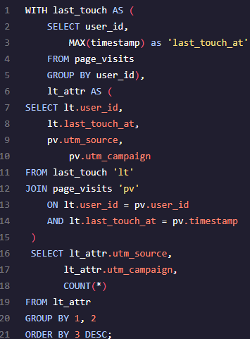
2. What is the User Journey? – Cont’d
How many last touches is each campaign responsible for?
Use the MAX statement to help determine which source and campaign aided to the last touch
Total of 8 campaigns drove last touch
Source | Campaign | Count
email | weekly-newsletter | 447
facebook | retargetting-ad | 443
email | retargetting-campaign | 245
nytimes | getting-to-know-cool-tshirts | 232
buzzfeed | ten-crazy-cool-tshirts-facts | 190
medium | interview-with-cool-tshirts-founder | 184
google | paid-search | 178
google | cool-tshirts-search | 60

Slide 9

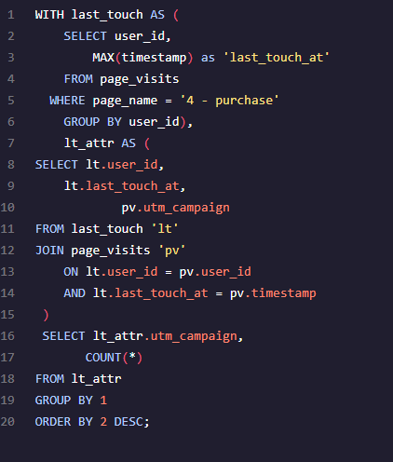
2. What is the User Journey? – Cont’d
How many visitors make a purchase?
Out of 1,979 first touch users, 361 make a purchase
18.24% conversion rate (361/1,979 = 18.24%)
# of Customers that make a Purchase
361
How many last touches on the purchase page is each campaign responsible for?
Utilize MAX statement where users visited the “purchase page”, which can help identify campaigns that aided in overall conversions
Campaign | Count
weekly-newsletter | 115
retargetting-ad | 113
retargetting-campaign | 54
paid-search | 52
ten-crazy-cool-tshirts-facts | 9
getting-to-know-cool-tshirts | 9
interview-with-cool-tshirts-founder | 7
cool-tshirts-search | 2

Slide 10
2. What is the TYPICAL User Journey?
91% of users engaged with the first 3 campaigns prior to arriving to site
* Interview with Cool Tshirts founder
* Getting to know Cool Tshirts
* Ten crazy Cool Tshirts facts
These campaigns look to focus more around story-telling/attention-grabbing creative
Despite story-telling/attention-grabbing creative, users still need additional reminders in order to go lower in the funnel to complete a purchase
Only about 7% of “story-telling” campaigns generated purchases, hence the need to serve additional campaigns to user
78% of purchases came from email newsletter and re-targeting campaigns
Additional reminders/re-targeting was a strong tactic that helped drive users lower down the funnel to a purchase conversion
*46% of purchases came from re-targeting campaigns
First Touch
Last Touch
Purchase by Campaign
Campaign | Count
interview-with-cool-tshirts-founder | 622
getting-to-know-cool-tshirts | 612
ten-crazy-cool-tshirts-facts | 576
cool-tshirts-search | 169
Campaign | Count
weekly-newsletter | 447
retargetting-ad | 443
retargetting-campaign | 245
getting-to-know-cool-tshirts | 232
ten-crazy-cool-tshirts-facts | 190
interview-with-cool-tshirts-founder | 184
paid-search | 178
cool-tshirts-search | 60
Campaign | Count
weekly-newsletter | 115
retargeting-ad | 113
retargeting-campaign | 54
paid-search | 52
ten-crazy-cool-tshirts-facts | 9
getting-to-know-cool-tshirts | 9
interview-with-cool-tshirts-founder | 7
cool-tshirts-search | 2

Slide 11
3. Optimize the Campaign Budget

Slide 12
3. Which 5 campaigns should CoolTShirts re-invest in?
The top 3 campaigns for First Touch should be used strictly for engaging the target audience initially, as these drove a great initial response
Re-targeting proved to be a valuable way to re-engage users to complete purchases
*Facebook drove the highest last-touch results, however email still provided a sufficient amount of conversions. Despite only picking top 5 campaigns, CoolTShirts still should consider email-remarketing for future campaigns under a holistic “re-targeting” budget to compare results again with FB vs. Email.
Would recommend to test re-targeting outside of email/facebook and engage with users who came from sources like medium, nytimes, and Buzzfeed to see how that audience would go through the purchase funnel
Aside from re-targeting, the Newsletter campaign provided strong conversions and should continue to have budget behind it. CoolTShirts should look at performance WoW for the newsletter to see if certain topics covered each week drove a higher conversion rate
First Touch
Source | Campaign | Count
medium | interview-with-cool-tshirts-founder | 622
nytimes | getting-to-know-cool-tshirts | 612
buzzfeed | ten-crazy-cool-tshirts-facts | 576
google | cool-tshirts-search | 169
Last Touch on Purchase Page
Source | Campaign | Count
email | weekly-newsletter | 115
facebook | retargetting-ad | 113
email | retargetting-campaign | 54
google | paid-search | 52
buzzfeed | ten-crazy-cool-tshirts-facts | 9
nytimes | getting-to-know-cool-tshirts | 9
medium | interview-with-cool-tshirts-founder | 7
google | cool-tshirts-search | 2
Top 5 Campaigns

Slide 13
Thank You!

